Slide 1
Review Session2
October 28, 2019

Slide 2
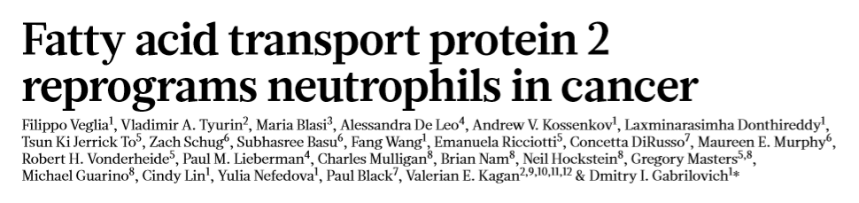
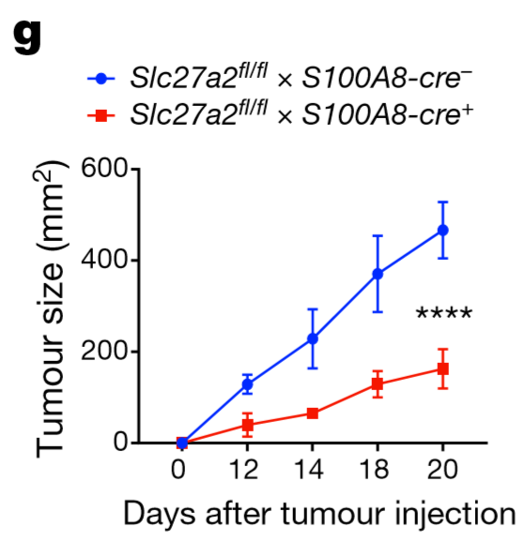
2 MAY 2019 | Voll 569 | Nature |
Fig. 1 | The effect of FATP2 deletion on tumour growth and PMNMDSC function.
g, LLC tumours in Slc27a2fl/fl mice crossed with S100a8-cre mice, to target the FATP2 depletion to PMNs (n = 4).
*P < 0.05, **P < 0.01, ***P < 0.001, ****P < 0.0001 (between control and test samples), unpaired two-sided Student’s t-test (a–c) or two-way analysis of variance (ANOVA) (d–g).

Slide 3
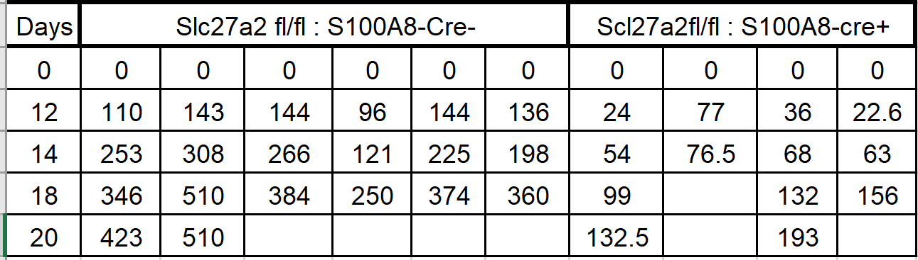
two-way ANOVA?
Tumour growth was evaluated using a two-way ANOVA test with Bonferroni correction for multiple comparisons.

Slide 4
Tumour cell injections and treatment. Approximately 5 × 105 tumour cells were injected subcutaneously into mice, which formed tumours with a 1.5-cm diameter within 2–3 weeks of injection. Lipofermata was administrated subcutaneously at a dose of 2 mg kg−1 twice a day. As a control, mice were treated with vehicle alone (DMSO plus 30% (v/v) Kolliphor). Treatments with lipofermata started 8–10 days after tumour injections. CSF1R antibody (BioXcell, 300 µg per mouse) was administered every other day starting the day after tumour injection, and continued until the mice were euthanized. PD-1 antibody (clone RMP1-14, BioXcell, 200 µg per mouse) was administered twice a week started 10–12 days after tumour injection. CTLA4-IgG2a (BioXcell, 200 µg per mouse) was administered at days 7 and 11.

Slide 5
Assumptions
Means | Male | Female
Diet1 | 10.2 | 9.8
Diet2 | 12.5 | 8.7
All cells (groups) of the study design should be normal
Less important for large sample sizes
The samples must be independent
Observations or participants must be independent
Participants in one group cannot influence participants in another
Homoscedasticity in every cell.
The cells should have the same sample size

Slide 6
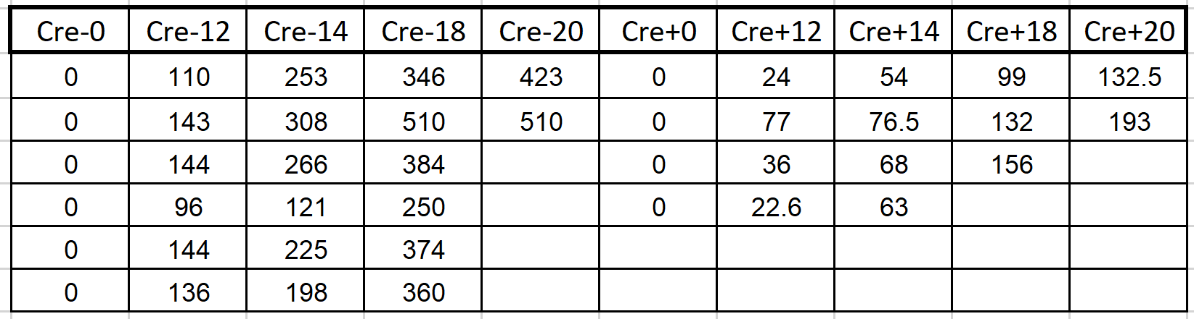

Slide 7
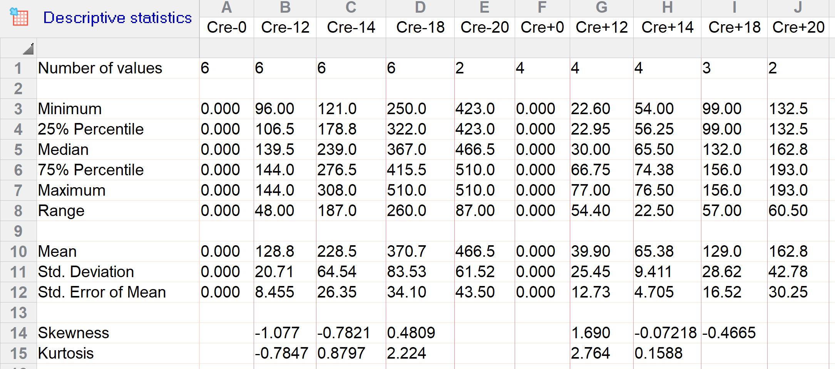
Normal?
Homoscedastic?
Independent?
Equal sample sizes?
Statistical analysis. Statistical analysis was performed using an unpaired two-tailed Student’s t-test with significance determined at P = 0.05. Estimation of variation within each group of data was performed and variance was similar between groups that were compared. Animal experiments were not blinded. Tumour growth was evaluated using a two-way ANOVA test with Bonferroni correction for multiple comparisons.

Slide 8
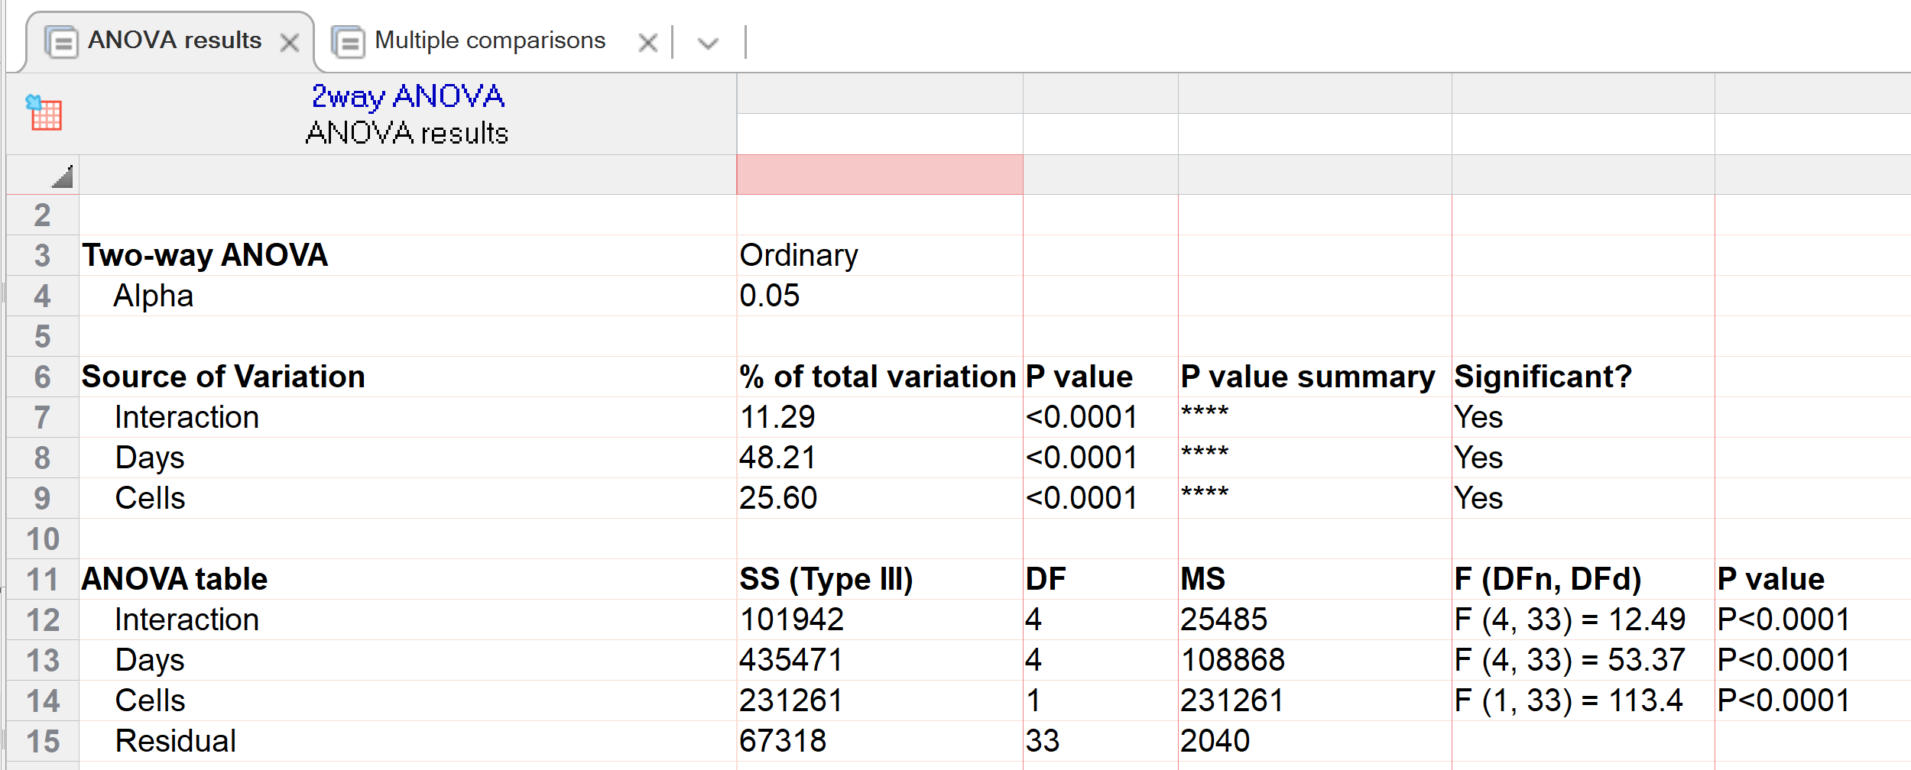
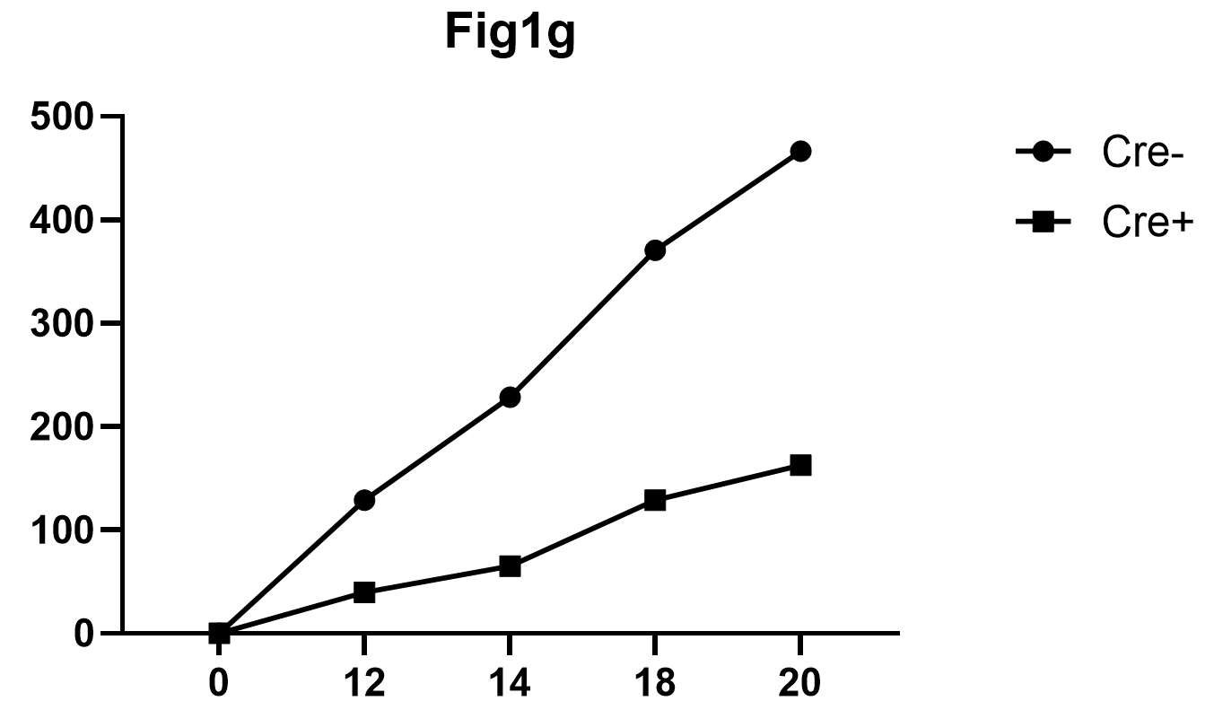

Slide 9
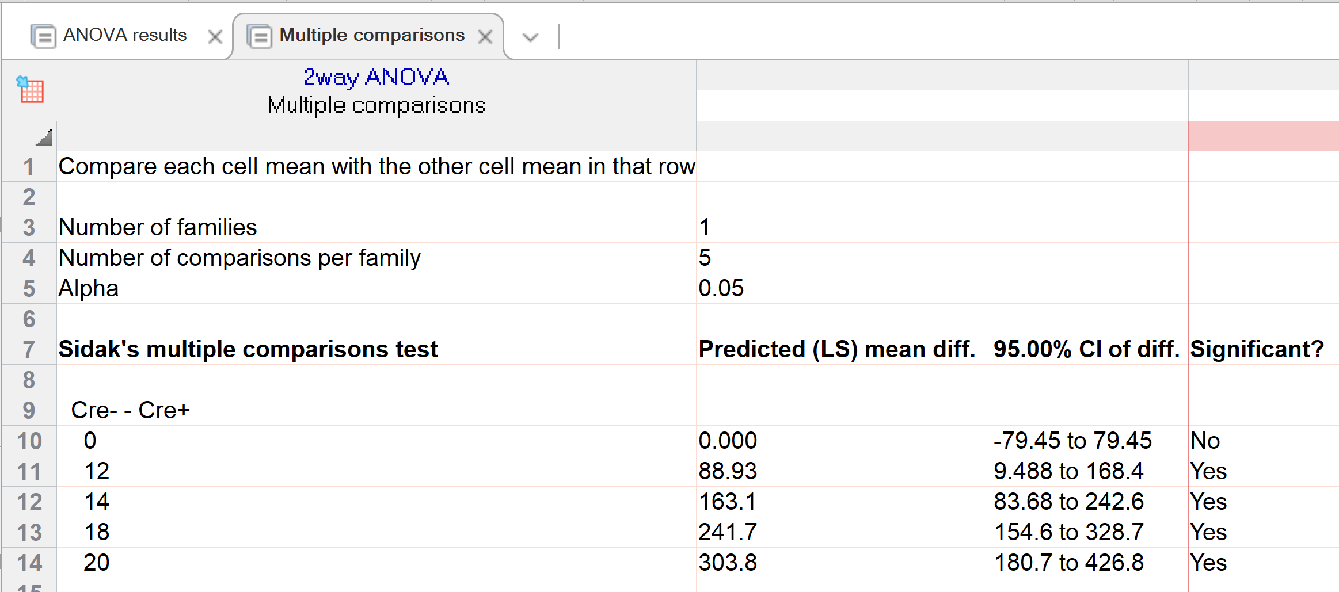
Does the x –axis look odd?

Slide 10
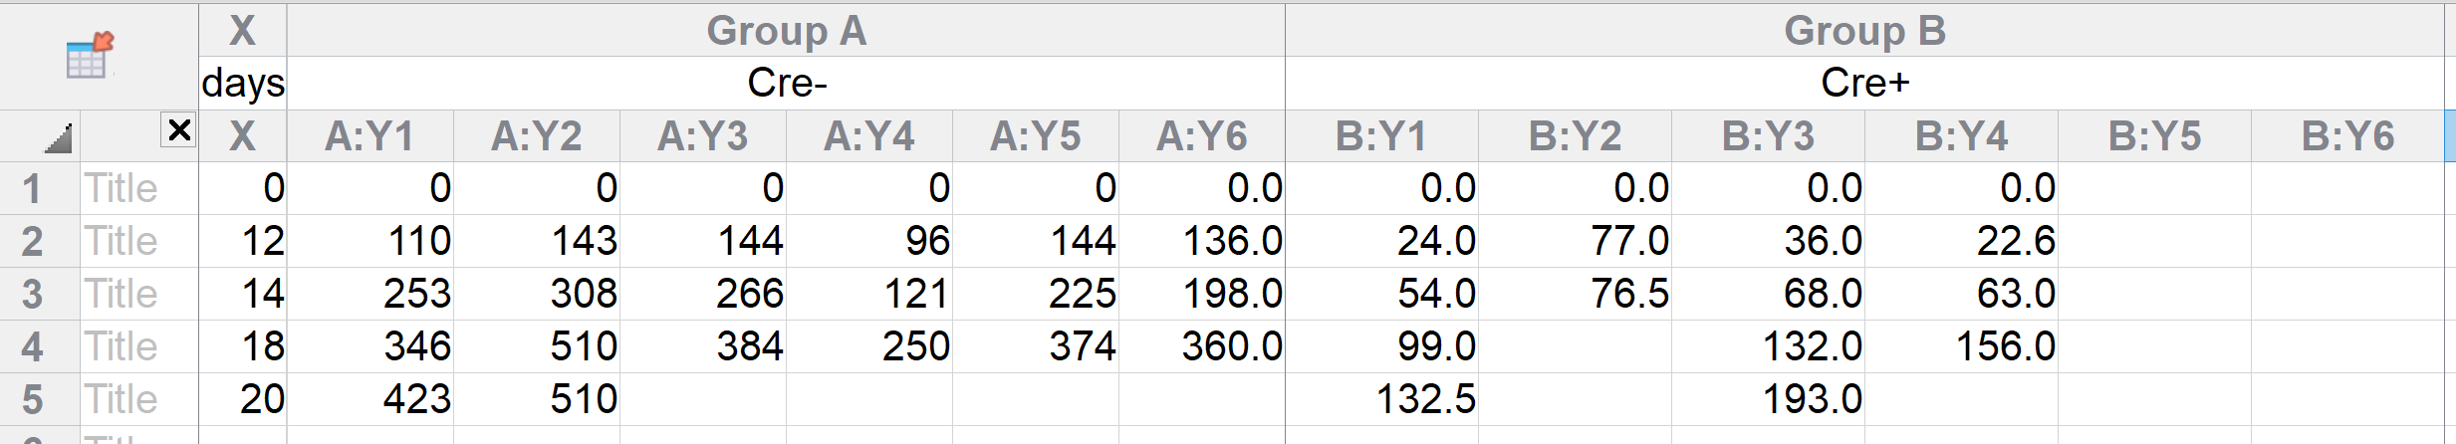
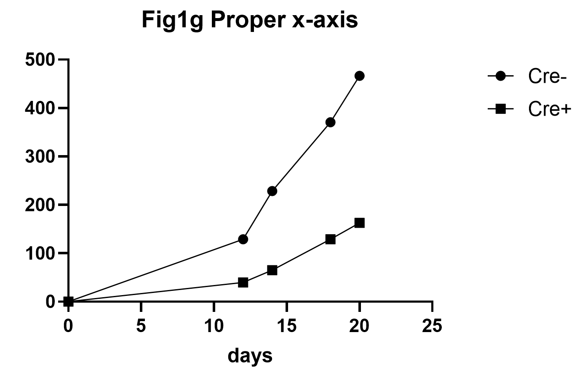
XY Table

Slide 11
RM ANOVA assumptions
Dependent variable should be continuous (tumor volume)
Independent variable(s) should be categorical with >2 levels (5x2)
Time intervals for repeated measures should be equal (0, 12, 14, 18, 20days)
Subjects are independent (10 different mice)
Data should be normally distributed and with no outliers by group (see next slide) (No, to can’t really tell)
Homoscedasticity by group (No)
The data should show ‘sphericity’ across groups (will not look at)
There should be no missing data (Yes there are)

Slide 12
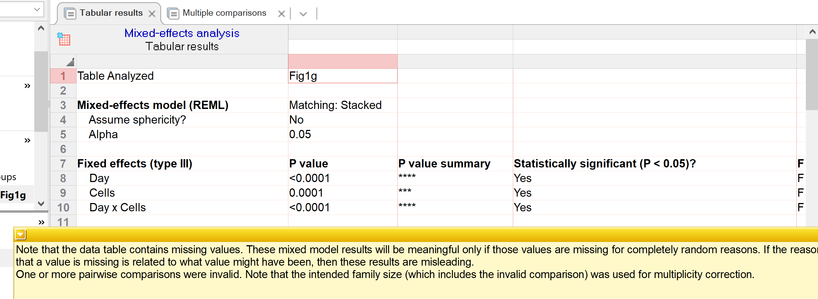
Mixed model

Slide 13
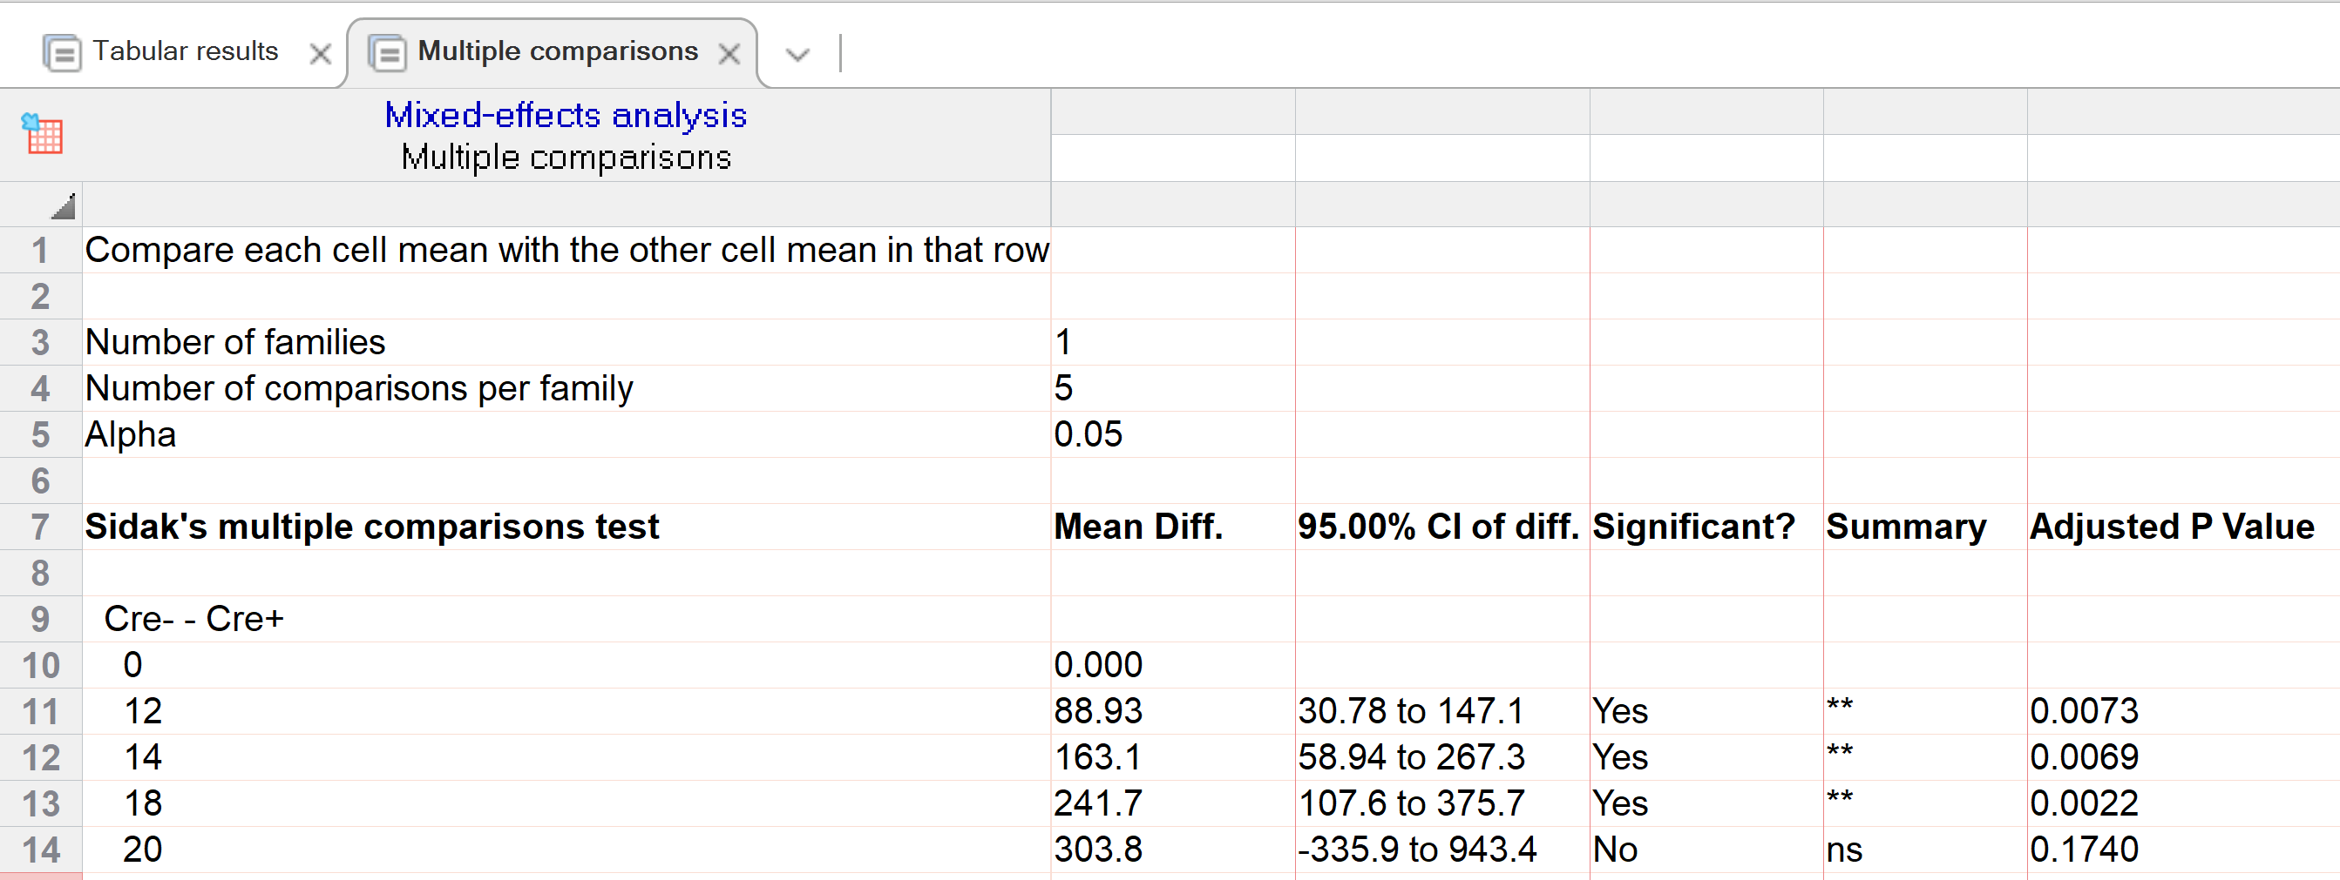

Slide 14
2 MAY 2019 | Voll 569 | Nature |
Fig. 1 | The effect of FATP2 deletion on tumour growth and PMNMDSC function.
g, LLC tumours in Slc27a2fl/fl mice crossed with S100a8-cre mice, to target the FATP2 depletion to PMNs (n = 4).
*P < 0.05, **P < 0.01, ***P < 0.001, ****P < 0.0001 (between control and test samples), unpaired two-sided Student’s t-test (a–c) or two-way analysis of variance (ANOVA) (d–g).
Did the authors do the correct data analysis and the best data presentation?

Slide 15
Midterm hints:
For all null and alternative hypotheses remember that they are about the population, so either use Greek letters or state something about the population if you write it out.
For tests that use ranks (i.e., Mann Whitney), remember the test is looking at differences in the distribution of ranks of the data. Many people say that the test is looking a the differences in medians of the raw data. But you can get a p<0.05 for a Mann Whitney test even if the medians are the same. The underlying rank distribution is different. If you need to state a null hypothesis for a non-parametric test for the midterm, say the medians of the population are equal but also include a statement that the distribution of the ranks in the population are the same.

Slide 16
Remember:
Bring only your study guide plus one blank sheet of paper for calculations if you need it.
3 pages front and back
The only electronic device you can use is a calculator.
Questions?
Practice datasets

